Slide 1
CSE450
Data Mining
Week 6:
  Nearest Neighbor Learning

Slide 2
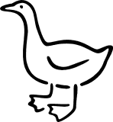
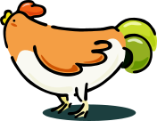
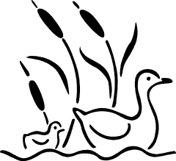

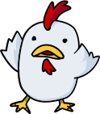
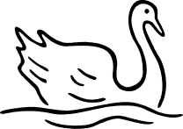
Nearest Neighbor Classifier
Basic idea:
  If it walks like a duck, quacks like a duck, then it’s probably a duck
Compute Distance
Test Record
Training Records
Choose k of the “nearest” records

Slide 3
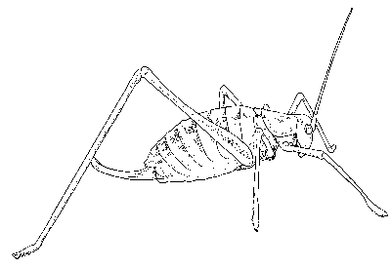

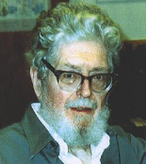
Nearest Neighbor Classifier
10
9
8
7
Evelyn Fix
1904-1965
Joe Hodges
1922-2000
6
Antenna Length
5
If the nearest instance to the previously unseen instance is a Katydid
class is Katydid
else
class is Grasshopper
4
3
2
1
Katydids
Grasshoppers
1
2
3
4
5
6
7
8
9
10
Abdomen Length

Slide 4
Different Learning Methods
Eager Learning
  Explicit description of target function on the whole training set
  Pretty much all other methods we will discuss
Instance-based Learning
  Learning=storing all training instances
  Classification=assigning target function to a new instance
  Referred to as “Lazy” learning

Slide 5
Instance-Based Classifiers
Examples:
  Rote-learner
    Memorizes entire training data and performs classification only if attributes of record exactly match one of the training examples
      No generalization
  Nearest neighbor
    Uses k “closest” points (nearest neighbors) for performing classification
      Generalizes

Slide 6
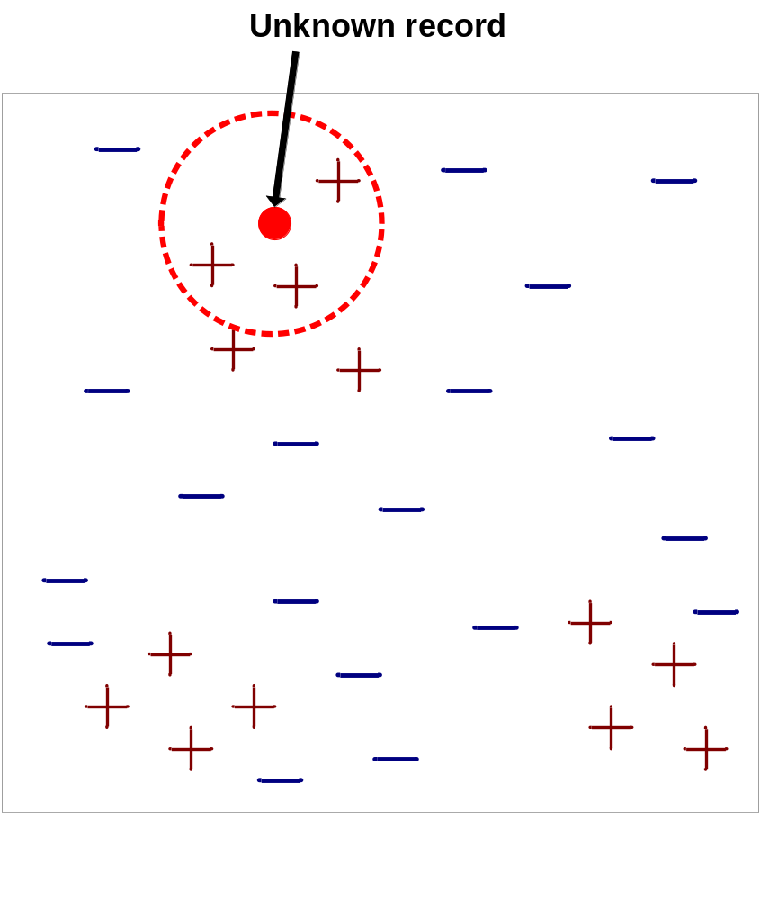
Nearest-Neighbor Classifiers
Requires three things
  The set of stored records
  Distance metric to compute distance between records
  The value of k, the number of nearest neighbors to retrieve
To classify an unknown record:
  Compute distance to other training records
  Identify k nearest neighbors
  Use class labels of nearest neighbors to determine the class label of unknown record (e.g., by taking majority vote)

Slide 7

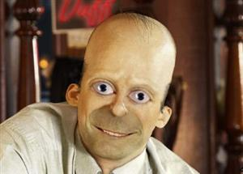
Similarity and Distance
One of the fundamental concepts of data mining is the notion of similarity between data points, often formulated as a numeric distance between data points.
Similarity is the basis for many data mining procedures.
We learned a bit about similarity when we discussed data
We will consider the most direct use of similarity today.
Later we will see it again (for clustering)

Slide 8
kNN learning
Assumes X = n-dim. space
  discrete or continuous f(x)
Let
  x = <a₁(x),…,a_{n}(x)>
  d(x_{i},x_{j}) = Euclidean distance
Algorithm (given new x)
  find k nearest stored x_{i} (use d(x, x_{i}))
  take the most common value of f

Slide 9


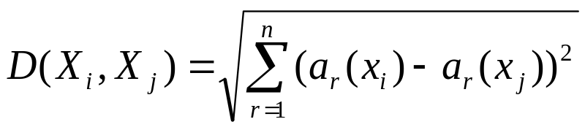
Similarity/Distance Between Data Items
Each data item is represented with a set of attributes (consider them to be numeric for the time being)
“Closeness” is defined in terms of the distance (Euclidean or some other distance) between two data items.
  The Euclidean distance between X_{i}=<a₁(X_{i}),…,a_{n}(X_{i})> and X_{j}= <a₁(X_{j}),…,a_{n}(X_{j})> is defined as:
  Distance(John, Rachel) = sqrt[(35-22)²+(35K-50K)²+(3-2)²]
John:
Age = 35
Income = 35K
No. of credit cards = 3
Rachel:
Age = 22
Income = 50K
No. of credit cards = 2

Slide 10
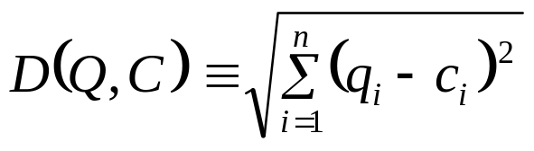
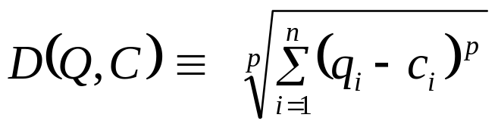
Up to now we have assumed that the nearest neighbor algorithm uses the Euclidean Distance, however this need not be the case…
10
9
Max (p=inf)
8
7
6
Manhattan (p=1)
5
4
Weighted Euclidean
3
2
1
Mahalanobis
1
2
3
4
5
6
7
8
9
10

Slide 11
Other Distance Metrics
Mahalanobis distance
  Scale-invariant metric that normalizes for variance.
Cosine Similarity
  Cosine of the angle between the two vectors.
  Used in text and other high-dimensional data.
Pearson correlation
  Standard statistical correlation coefficient.
  Used for bioinformatics data.
Edit distance
  Used to measure distance between unbounded length strings.
  Used in text and bioinformatics.

Slide 12
Similarity/Distance Between Data Items
Each data item is represented with a set of attributes (consider them to be numeric for the time being)
“Closeness” is defined in terms of the distance (Euclidean or some other distance) between two data items.
  The Euclidean distance between X_{i}=<a₁(X_{i}),…,a_{n}(X_{i})> and X_{j}= <a₁(X_{j}),…,a_{n}(X_{j})> is defined as:
  Distance(John, Rachel) = sqrt[(35-22)²+(35K-50K)²+(3-2)²]
John:
Age = 35
Income = 35K
No. of credit cards = 3
Rachel:
Age = 22
Income = 50K
No. of credit cards = 2

Slide 13
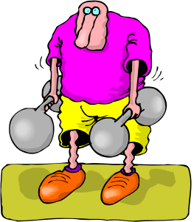



Nearest Neighbors for Classification
To determine the class of a new example E:
  Calculate the distance between E and all examples in the training set
  Select k examples closest to E in the training set
  Assign E to the most common class (or some other combining function) among its k nearest neighbors
No response
Response
No response
Response
Class: Response
No response

Slide 14
k-Nearest Neighbor Algorithms
(a.k.a. Instance-based learning (IBL), Memory-based learning)
No model is built: Store all training examples
Any processing is delayed until a new instance must be classified → lazy classification technique
No response
Response
No response
Response
Class: Response
No response

Slide 15

k-Nearest Neighbor Classifier
Example (k=3)
Customer | Age | Income (K) | No. of cards | Response
John | 35 | 35 | 3 | Yes
Rachel | 22 | 50 | 2 | No
Ruth | 63 | 200 | 1 | No
Tom | 59 | 170 | 1 | No
Neil | 25 | 40 | 4 | Yes
David | 37 | 50 | 2 | ?
Distance from David
sqrt [(35-37)²+(35-50) ² +(3-2) ²]=15.16
sqrt [(22-37)²+(50-50)² +(2-2)²]=15
sqrt [(63-37) ²+(200-50) ² +(1-2) ²]=152.23
sqrt [(59-37) ²+(170-50) ² +(1-2) ²]=122
sqrt [(25-37) ²+(40-50) ² +(4-2) ²]=15.74
sqrt [(35-37)²+(35-50) ²
+(3-2) ²]=15.16
sqrt [(22-37)²+(50-50)²
+(2-2)²]=15
sqrt [(25-37) ²+(40-50) ²
+(4-2) ²]=15.74
Yes

Slide 16
Strengths and Weaknesses
Strengths:
  Simple to implement and use
  Comprehensible – easy to explain prediction
  Robust to noisy data by averaging k-nearest neighbors
  Distance function can be tailored using domain knowledge
  Can learn complex decision boundaries
    Much more expressive than linear classifiers & decision trees
    More on this later
Weaknesses:
  Need a lot of space to store all examples
  Takes much more time to classify a new example than with a parsimonious model (need to compare distance to all other examples)
  Distance function must be designed carefully with domain knowledge

Slide 17
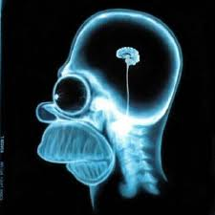

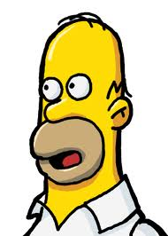
Are These Similar at All?
Humans would say “yes” although not perfectly so (both Homer)
Nearest Neighbor method without carefully crafted features would say “no’” since the colors and other superficial aspects are completely different. Need to focus on the shapes.
Notice how humans find the image to the right to be a bad representation of Homer even though it is a nearly perfect match of the one above.

Slide 18
Strengths and Weaknesses I
John:
Age = 35
Income = 35K
No. of credit cards = 3
Rachel:
Age = 22
Income = 50K
No. of credit cards = 2
  Distance(John, Rachel) = sqrt[(35-22)²+(35,000-50,000)²+(3-2)²]
Distance between neighbors can be dominated by an attribute with relatively large values (e.g., income in our example).
Important to normalize (e.g., map numbers to numbers between 0-1)
  Example: Income
  Highest income = 500K
  John’s income is normalized to 95/500, Rachel’s income is normalized to 215/500, etc.)
(there are more sophisticated ways to normalize)

Slide 19
The nearest neighbor algorithm is sensitive to the units of measurement
X axis measured in centimeters
Y axis measure in dollars
The nearest neighbor to the pink unknown instance is red.
X axis measured in millimeters
Y axis measure in dollars
The nearest neighbor to the pink unknown instance is blue.
One solution is to normalize the units to pure numbers. Typically the features are Z-normalized to have a mean of zero and a standard deviation of one. X = (X – mean(X))/std(x)

Slide 20
Feature Relevance and Weighting
Standard distance metrics weight each feature equally when determining similarity.
  Problematic if many features are irrelevant, since similarity along many irrelevant examples could mislead the classification.
Features can be weighted by some measure that indicates their ability to discriminate the category of an example, such as information gain.
Overall, instance-based methods favor global similarity over concept simplicity.
+
Training
Data
–
+
Test Instance
??

Slide 21
Strengths and Weaknesses II
Distance works naturally with numerical attributes
  Distance(John, Rachel) = sqrt[(35-22)²+(35,000-50,000)²+(3-2)²] = 15.16
What if we have nominal/categorical attributes?
  Example: married
Customer | Married | Income (K) | No. of cards | Response
John | Yes | 35 | 3 | Yes
Rachel | No | 50 | 2 | No
Ruth | No | 200 | 1 | No
Tom | Yes | 170 | 1 | No
Neil | No | 40 | 4 | Yes
David | Yes | 50 | 2 | ?

Slide 22
Recall: Geometric interpretation of classification models
Age
+
+
+
+
+
+
+
+
+
+
+
+
+
+
+
45
50K
Balance
Bad risk (Default) – 16 cases
Good risk (Not default) – 14 cases
+

Slide 23
How does a 1-nearest-neighbor classifier partition the space?
Very different boundary (in comparison to what we have seen)
Very tailored to the data that we have
Nothing is ever wrong on the training data
Maximal overfitting
Age
+
+
+
+
+
+
+
+
+
+
+
+
+
+
+
45
50K
Balance
Bad risk (Default) – 16 cases
Good risk (Not default) – 14 cases
+

Slide 24
We can visualize the nearest neighbor algorithm in terms of a decision surface…
Note the we don’t actually have to construct these surfaces, they are simply the implicit boundaries that divide the space into regions “belonging” to each instance.
Although it is not necessary to explicitly calculate these boundaries, the learned classification rule is based on regions of the feature space closest to each training example.
This division of space is called Dirichlet Tessellation (or Voronoi diagram, or Theissen regions).

Slide 25
The nearest neighbor algorithm is sensitive to outliers…
The solution is to…

Slide 26
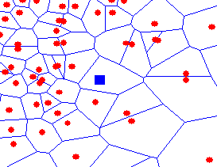
We can generalize the nearest neighbor algorithm to the k- nearest neighbor (kNN) algorithm.
We measure the distance to the nearest k instances, and let them vote. k is typically chosen to be an odd number.
k – complexity control for the model
K = 1
K = 3

Slide 27
Curse of Dimensionality
Distance usually relates to all the attributes and assumes all of them have the same effects on distance
The similarity metrics do not consider the relation of attributes which result in inaccurate distance and then impact on classification precision. Wrong classification due to presence of many irrelevant attributes is often termed as the curse of dimensionality
For example
  If each instance is described by 20 attributes out of which only 2 are relevant in determining the classification of the target function.
  Then instances that have identical values for the 2 relevant attributes may nevertheless be distant from one another in the 20dimensional instance space.

Slide 28
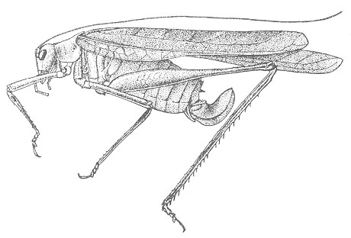
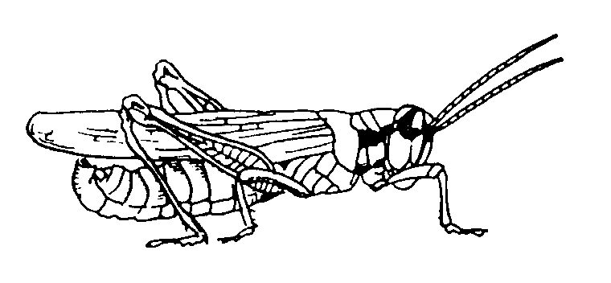
The nearest neighbor algorithm is sensitive to irrelevant features…
Suppose the following is true, if an insects antenna is longer than 5.5 it is a Katydid, otherwise it is a Grasshopper.
Using just the antenna length we get perfect classification!
Training data
1
2
3
4
5
6
7
8
9
10
6
1
2
3
4
5
6
7
8
9
10
1
2
3
4
5
6
7
8
9
10
5
10
Suppose however, we add in an irrelevant feature, for example the insects mass.
Using both the antenna length and the insects mass with the 1-NN algorithm we get the wrong classification!
9
8
7
6
5
4
3
2
1
1
2
3
4
5
6
7
8
9
10
1
2
3
4
5
6
7
8
9
10

Slide 29
How do we Mitigate Irrelevant Features?
Use more training instances
Ask an expert what features are relevant
Use statistical tests
Search over feature subsets

Slide 30
Why Searching over Feature Subsets is Hard
Suppose you have the following classification problem, with 100 features. Features 1 and 2 (the X and Y below) give perfect classification, but all 98 of the other features are irrelevant…
Only Feature 2
Only Feature 1
Using all 100 features will give poor results, but so will using only Feature 1, and so will using Feature 2! Of the 2¹⁰⁰ –1 possible subsets of the features, only one really works.

Slide 31
k-Nearest Neighbor Classification (kNN)
Unlike all the previous learning methods, kNN does not build model from the training data.
To classify a test instance d, define k-neighborhood P as k nearest neighbors of d
Count number n of training instances in P that belong to class c_{j}
Estimate Pr(c_{j}|d) as n/k
No training is needed. Classification time is linear in training set size for each test case.

Slide 32
Nearest Neighbor Variations
Can be used to estimate the value of a real-valued function (regression) by taking the average function value of the k nearest neighbors to an input point.
All training examples can be used to help classify a test instance by giving every training example a vote that is weighted by the inverse square of its distance from the test instance.

Slide 33
Example: k=6 (6NN)
Government
Science
Arts
A new point
Pr(science| )?

Slide 34
kNN - Important Details
kNN estimates the value of the target variable by some function of the values for the k-nearest neighbors. The simplest techniques are:
  for classification: majority vote
  for regression: mean/median/mode
  for class probability estimation: fraction of positive neighbors
For all of these cases, it may make sense to create a weighted average based on the distance to the neighbors, so that closer neighbors have more influence in the estimation.
In Weka: classifiers →lazy → IBk (for “instance based”)
  parameters for distance weighting and automatic normalization
  can set k automatically based on (nested) cross-validation

Slide 35
Case-based Reasoning (CBR)
CBR is similar to instance-based learning
  But may reason about the differences between the new example and match example
CBR Systems are used a lot
  help-desk systems
  legal advice
  planning & scheduling problems
  Next time you are on the help with tech support
    The person maybe asking you questions based on prompts from a computer program that is trying to most efficiently match you to an existing case!

